Slide 1
Introduction to Machine Learning

Slide 2
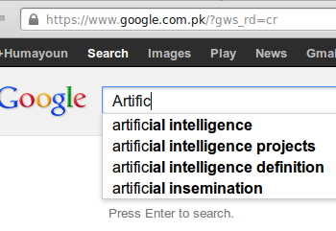
Motivation
Machine Learning is one of the most exiting area
Its everywhere
SPAM

Slide 3
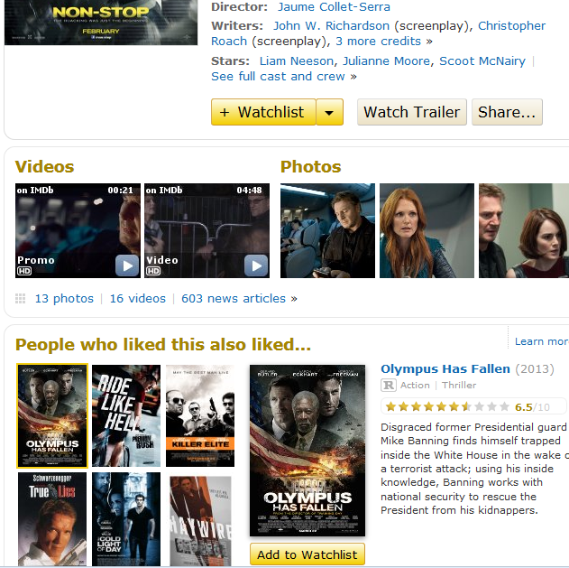
www.imdb.com

Slide 4
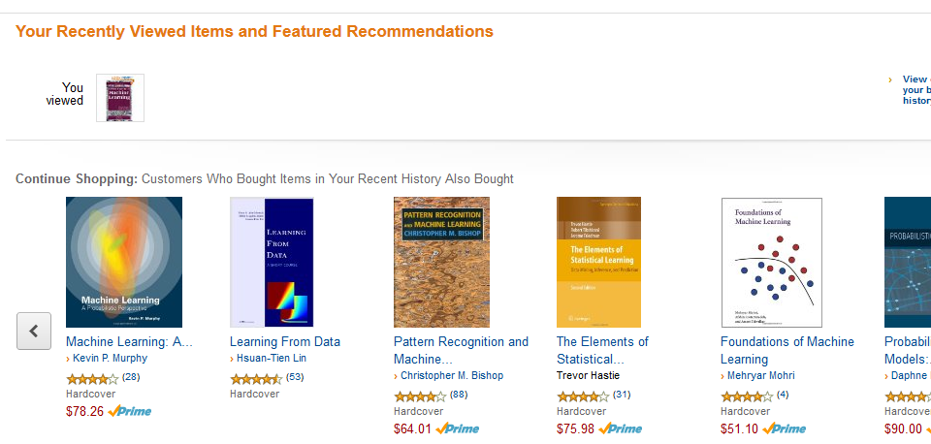
www.amazon.com

Slide 5
Machine Learning
Grew out of work in AI
Aim: building intelligent machines
What we knew already: Program a machine to find the shortest path from A to B (for example)
Did not know much: How to write AI programs that can do more interesting things like web search, photo tagging or email anti-spam, driverless car, etc.
Realization: Machine learns to do it by itself
Machine learning was developed as a new capability for computers
Today it touches many segments of industry and science

Slide 6
ML application areas: Database mining
Large datasets from growth of automation/web
One of the reasons that ML becomes so wide spread
Web click data
Tons of companies collecting clickstream data for mining purpose
To understand the users better with machine learning algorithms
Huge segment of Software Industry working on it currently

Slide 7
ML application areas: Database mining
Electronic Medical records
Trying to turn medical records into medical knowledge, to understand disease better.
An evaluation of machine-learning methods for predicting pneumonia mortality
G. F. Cooper et al. 1997
Artificial Intelligence in Medicine, 9(2) 107-138

Slide 8
ML application areas: Database mining
Computational biology
Biologists collecting lots of data about gene sequences, DNA sequences, etc.
ML algorithms are giving us a much better understanding of the human genome Engineering

Slide 9
ML application areas:
Applications we can’t program by hand.
Autonomous helicopter, Google driverless car
Learns to do it by itself
Handwriting recognition
Postal Mail: A learning algorithm that has learned how to read postal code in your handwriting (US mail)
Most of Natural Language Processing (NLP) and Computer Vision today
Applied Machine learning

Slide 10
ML application areas:
Self-customizing programs
Amazon, IMDB, Youtube recommendations
Understanding human learning (brain, cognition)
Learning algorithms are being used today to understand human learning and to understand the brain.

Slide 11
An example application
An emergency room in a hospital measures 17 variables (e.g., blood pressure, age, etc) of newly admitted patients.
A decision is needed: whether to put a new patient in an intensive-care unit.
Due to the high cost of ICU, those patients who may survive less than a month are given higher priority.
Problem: to predict high-risk patients and discriminate them from low-risk patients.

Slide 12
Another application
A credit card company receives thousands of applications for new cards. Each application contains information about an applicant,
age
Marital status
annual salary
outstanding debts
credit rating
etc.
Problem: to decide whether an application should approved, or to classify applications into two categories, approved and not approved.

Slide 13
Machine learning is a highly desirable skill in IT industry and Computer Science research

Slide 14
Machine Learning definition
Arthur Samuel (1959). Machine Learning:
Field of study that gives computers the ability to learn without being explicitly programmed.
Tom Mitchell (1998) Well-posed Learning Problem: A computer program is said to learn from experience E with respect to some task T and some performance measure P, if its performance on T, as measured by P, improves with experience E.

Slide 15
“A computer program is said to learn from experience E with respect to some task T and some performance measure P, if its performance on T, as measured by P, improves with experience E.”
Suppose your email program watches which emails you do or do not mark as spam, and based on that learns how to better filter spam. What is the task T in this setting?
Classifying emails as spam or not spam.
Classifying emails as spam or not spam. T
Watching you label emails as spam or not spam.
Watching you label emails as spam or not spam. E
P
The number (or fraction) of emails correctly classified as spam/not spam.
None of the above—this is not a machine learning problem.

Slide 16
Topics
Machine learning algorithms:
Supervised learning
Unsupervised learning
Reinforcement learning
Bayesian Networks
Hidden Markov Models
Also talk about: Practical advice for applying learning algorithms. Implementation in Octave
Background Topics:
Linear Algebra
Probability

Slide 17
Machine learning and our focus
Like human learning from past experiences.
A computer does not have “experiences”.
A computer system learns from data, which represent some “past experiences” of an application domain.
Our focus: learn a target function that can be used to predict the values of a discrete class attribute, e.g., approve or not-approved, and high-risk or low risk.
The task is commonly called: Supervised learning, classification, or inductive learning.

Slide 18
The data and the goal
Data: A set of data records (also called examples, instances or cases) described by
k attributes: A₁, A₂, … A_{k}.
a class: Each example is labelled with a pre-defined class.
Goal: To learn a classification model from the data that can be used to predict the classes of new (future, or test) cases/instances.
Notes:
Induction is different from deduction and DBMS does not not support induction;
The result of induction is higher-level information or knowledge: general statements about data
There are many approaches. Refer to the lecture notes for CS3244 available at the Co-Op.
We focus on three approaches here, other examples:
Other approaches
Instance-based learning
other neural networks
Concept learning (Version space, Focus, Aq11, …)
Genetic algorithms
Reinforcement learning

Slide 19
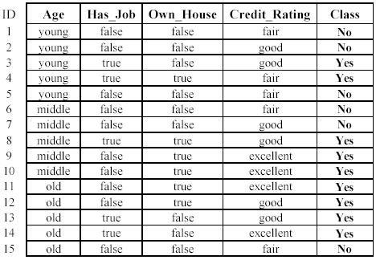
An example: data (loan application)
Approved or not

Slide 20
An example: the learning task
Learn a classification model from the data
Use the model to classify future loan applications into
Yes (approved) and
No (not approved)
What is the class for following case/instance?

Slide 21
Supervised vs. unsupervised Learning
Supervised learning: classification is seen as supervised learning from examples.
Supervision: The data (observations, measurements, etc.) are labeled with pre-defined classes. It is like that a “teacher” gives the classes (supervision).
Test data are classified into these classes too.
Unsupervised learning (clustering)
Class labels of the data are unknown
Given a set of data, the task is to establish the existence of classes or clusters in the data

Slide 22
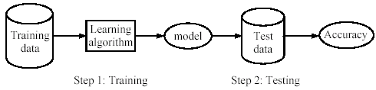
Supervised learning process: two steps
Learning (training): Learn a model using the training data
Testing: Test the model using unseen test data to assess the model accuracy

Slide 23
What do we mean by learning?
Given
a data set D,
a task T, and
a performance measure M,
a computer system is said to learn from D to perform the task T if after learning the system’s performance on T improves as measured by M.
In other words, the learned model helps the system to perform T better as compared to no learning.

Slide 24
An example
Data: Loan application data
Task: Predict whether a loan should be approved or not.
Performance measure: accuracy.
No learning: classify all future applications (test data) to the majority class (i.e., Yes):
Accuracy = 9/15 = 60%.
We can do better than 60% with learning.

Slide 25
Fundamental assumption of learning
Assumption: The distribution of training examples is identical to the distribution of test examples (including future unseen examples).
In practice, this assumption is often violated to certain degree.
Strong violations will clearly result in poor classification accuracy.
To achieve good accuracy on the test data, training examples must be sufficiently representative of the test data.

Slide 26
Housing price prediction.
quadratic function or second-order polynomial
Price ($)
in 1000’s
750
Size in feet²
Supervised Learning
“right answers” given
Regression: Predict continuous valued output (price)
Notes:
Regression is a statistical measurement used in finance, investing, and other disciplines that attempts to determine the strength of the relationship between one dependent variable (usually denoted by Y) and a series of other changing variables (known as independent variables).

Slide 27
What do we do if we have infinite number of features?
Support Vector Machine (SVM) algorithm can ideally deal with infinite number of features, with a neat mathematical trick
In supervised learning:
In every example in our data set, we are told what is the "correct answer”.
Data is labeled with answers

Slide 28
Classification: the output is binary or a fixed number of features. Ex. something is either a chair or not.
Regression is continuous. Ex. Tomorrow’s temperature might be 13 degrees in our prediction.

Slide 29
Problem 1: You have a large inventory of identical items. You want to predict how many of these items will sell over the next 3 months.
Problem 2: You’d like software to examine individual customer accounts, and for each account decide if it has been hacked/compromised.
Classification or regression problems?
Treat both as classification problems.
Treat problem 1 as a classification problem, problem 2 as a regression problem.
Treat problem 1 as a regression problem, problem 2 as a classification problem.
Treat both as regression problems.
Notes:
Just a quick wrap up question:

Slide 30
Supervised Learning Topics
Regression
Support Vector Machines
Neural Networks
Bayesian Learning
K Nearest Neighbors
Decision Trees
etc.

Slide 31
Unsupervised Learning
Data without “right answers”
Data doesn't have any labels
We're just told, here is a data set!
Can you find some structure in the data?

Slide 32
Supervised Learning
x₂
x₁

Slide 33
Unsupervised Learning
x₂
A clustering algorithm
x₁

Slide 34
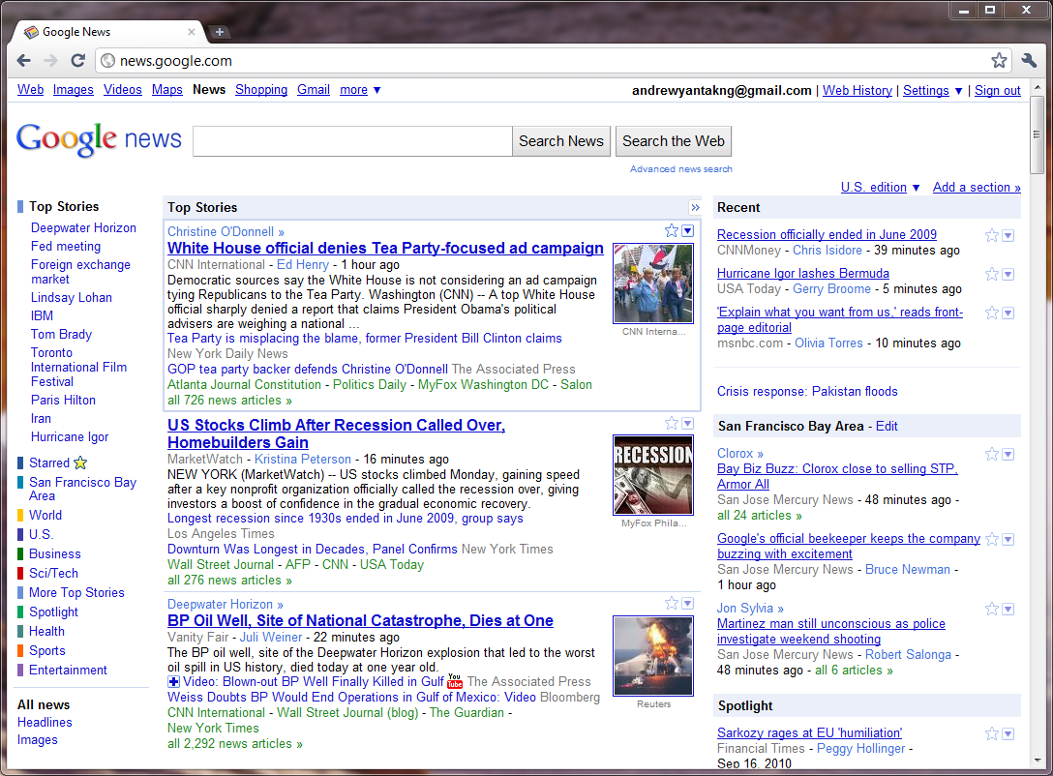

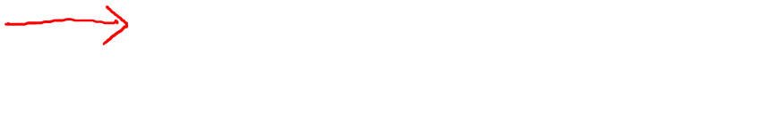

Slide 35

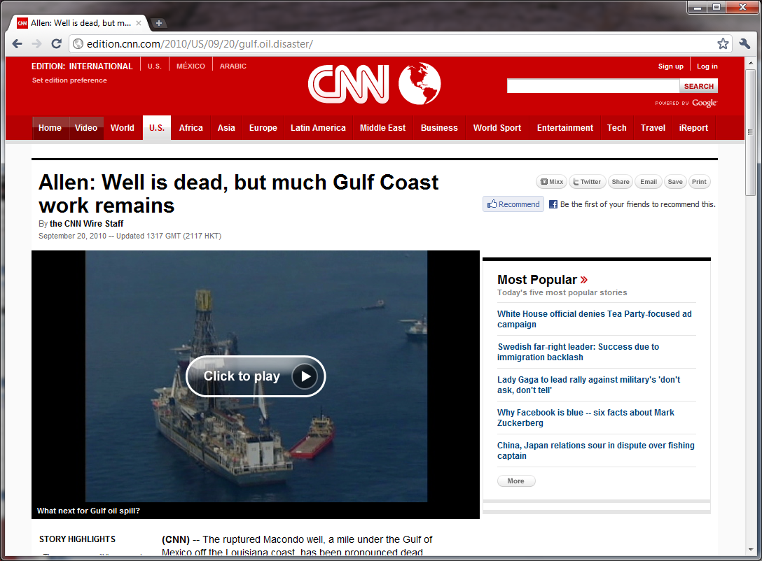


Slide 36
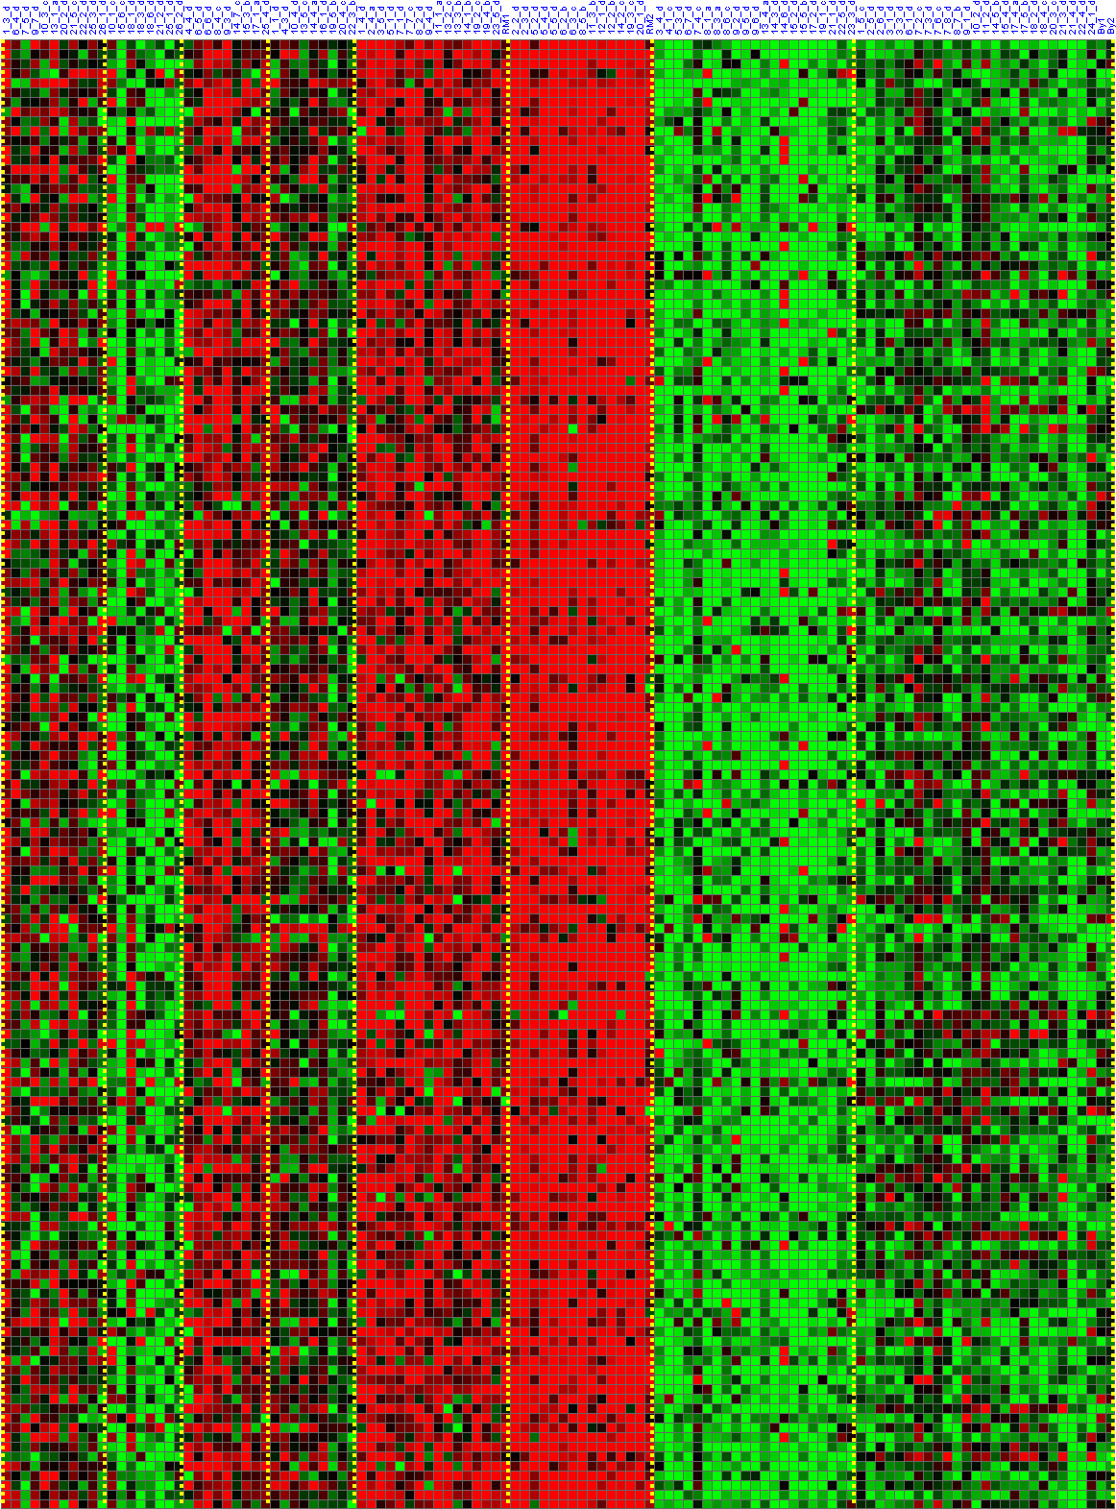
Genes
Individuals
DNA microarray data to understand genomics
Colors show the degree to which different individuals do or do not have a specific gene.
[Source: Daphne Koller]

Slide 37
Genes
Individuals
Cluster individuals into different categories or into different types of people.
[Source: Daphne Koller]

Slide 38
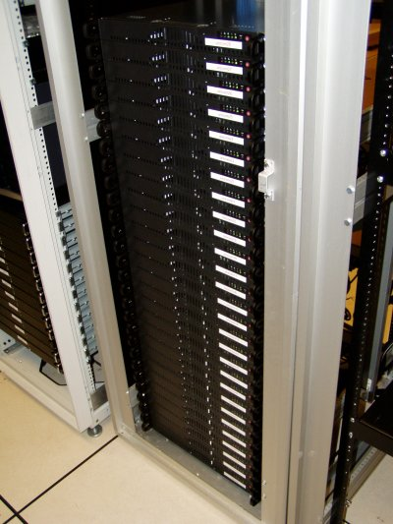
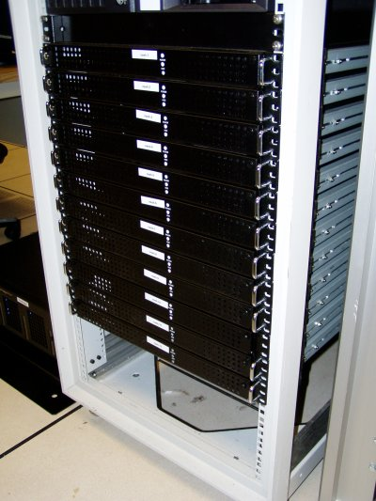
Organize computing clusters
Figure out which machines tend to work together using clustering algorithm
Then put those machines together, to make data center work more efficiently.

Slide 39


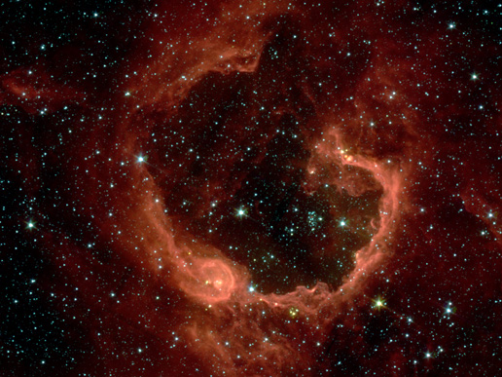
Social network analysis
Market segmentation
Image credit: NASA/JPL-Caltech/E. Churchwell (Univ. of Wisconsin, Madison)
Astronomical data analysis

Slide 40
Of the following examples, which would you address using an unsupervised learning algorithm?
(select all that apply.)
Given email labeled as spam/not spam, learn a spam filter.
Given a set of news articles found on the web, group them into set of articles about the same story.
Given a database of customer data, automatically discover market segments and group customers into different market segments.
Given a dataset of patients diagnosed as either having diabetes or not, learn to classify new patients as having diabetes or not.

Slide 41
Unsupervised Learning
K-means Clustering
A-priori Algorithm
Self-organizing Maps
Notes:
Apriori is an algorithm for frequent item set mining and association rule learning over relational databases. It proceeds by identifying the frequent individual items in the database and extending them to larger and larger item sets if those item sets appear sufficiently often in the database.

Slide 42
Reinforcement learning
Refers to problems where we don't do one-shot decision-making
E.g., in the supervised learning cancer prediction problem, we have a patient. We predict if tumor is malignant or benign. Later we’ll know either we got it right or wrong.
In reinforcement learning problems, we usually have to make a sequence of decisions over time.

Slide 43
Reinforcement learning
Examples: autonomous helicopter, driverless car
Cannot program by hand
Stochastic environment: too many possibilities
The basic idea is to define a “reward function”
Q Learning
Notes:
having a random probability distribution or pattern that may be analysed statistically but may not be predicted precisely.

Slide 44
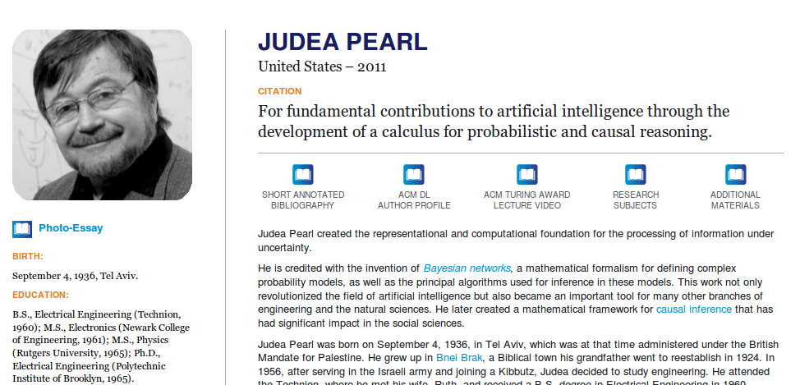
Probabilistic reasoning
Turing award (Nobel prize in Computer Science) for Bayesian networks

Slide 45
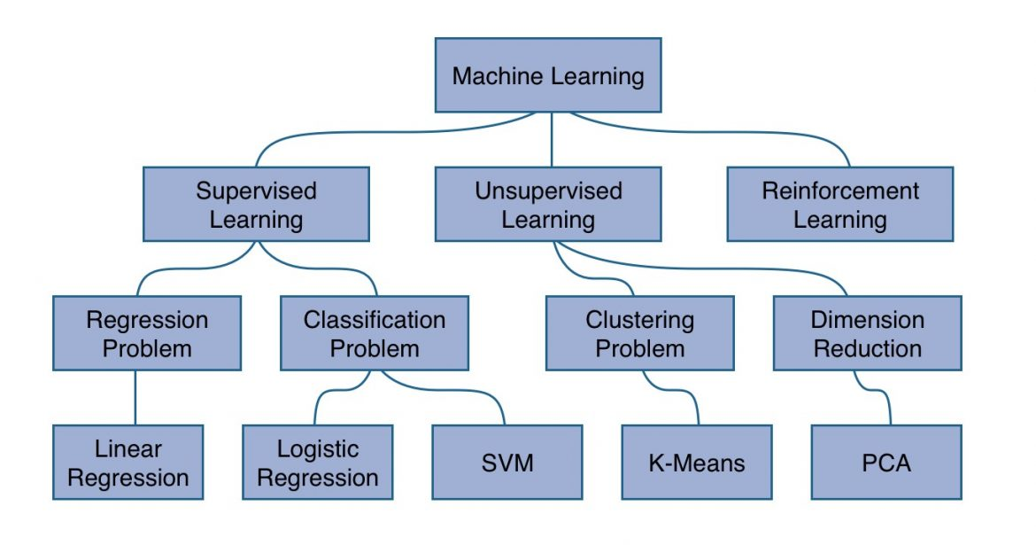

Slide 46
END

